Slide 2
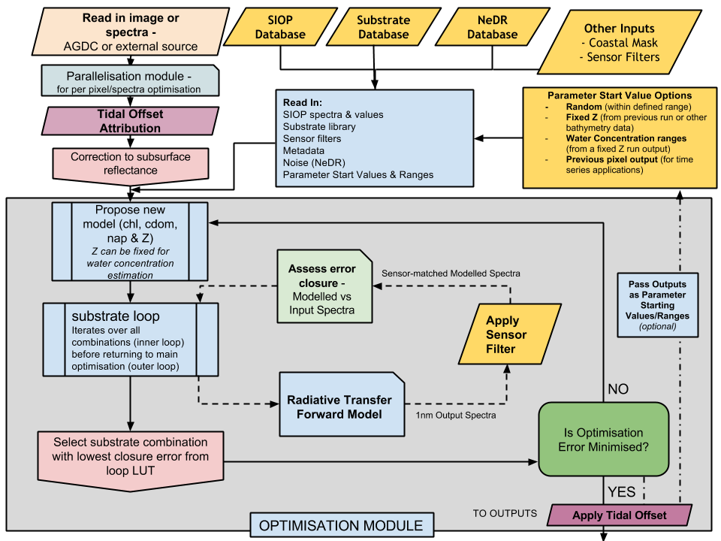

Slide 3
Data wrangling on NCI from AGDC
Data wrangling from other databases stored on NCI.
Table selected from drop down lists of above databases or custom-defined ranges or type of application (eg time series). New to current gui options would be an option to select otimisation step scales...(to be used with caution.
GUI – not in scope
This is where optimisation routine eg nelder-mead
This is where optimisation routine eg nelder-mead

